Slide 1

GENTECH CASE-STUDY
PRESENTED By:
VINIT VIJAYKUMAR ADKE
YASH SANJAYKUMAR PARDESHI
DHIRRAJ SURESH KUMAR
JASWANT GIRIDHARAGOPALAN

Slide 2
AGENDA:
DEFINE
Measure
Analyze
Improve
Control

Slide 3
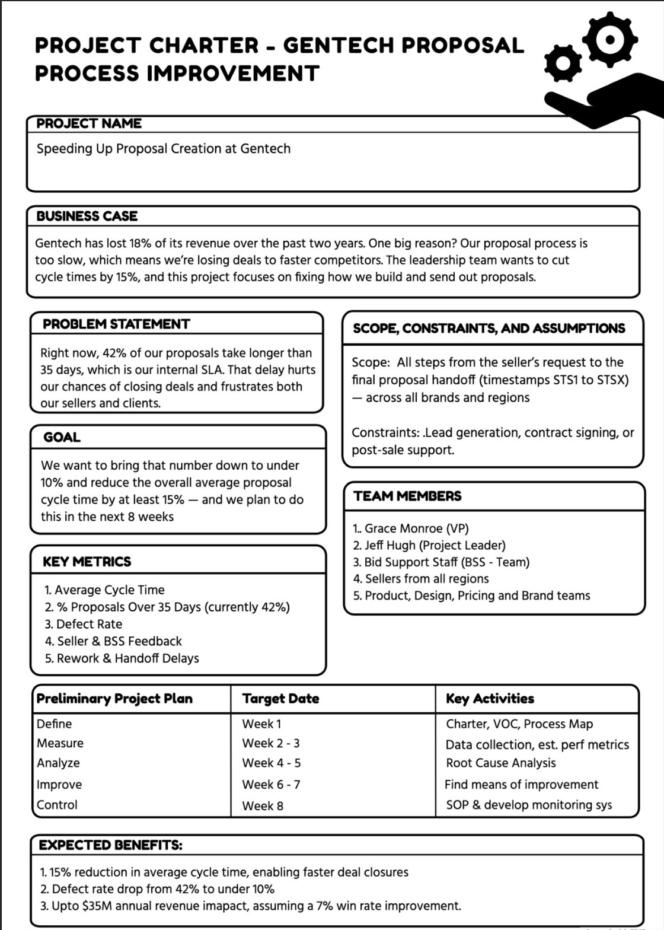
DEFINE: Charter
Problem Statement:
Right now, 28% of our proposals take >35 days, which is our internal SLA. That delay hurts our chances of closing deals and frustrates both our sellers and clients
Key Metrics:
1. Average Cycle Time
2. % Proposals over 35 days (currently 28%)
3. Defect Rate
4. Seller & BSS Feedback

Slide 4
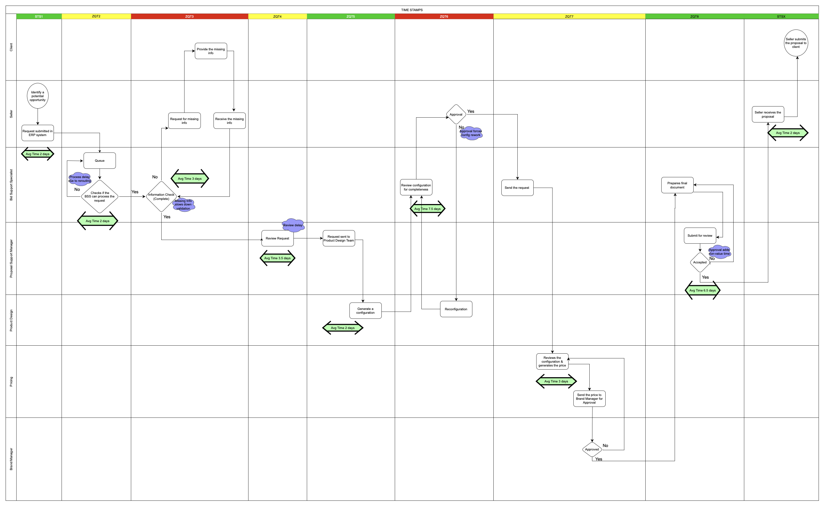
DEFINE: Swim-Lane Flowchart

Slide 5
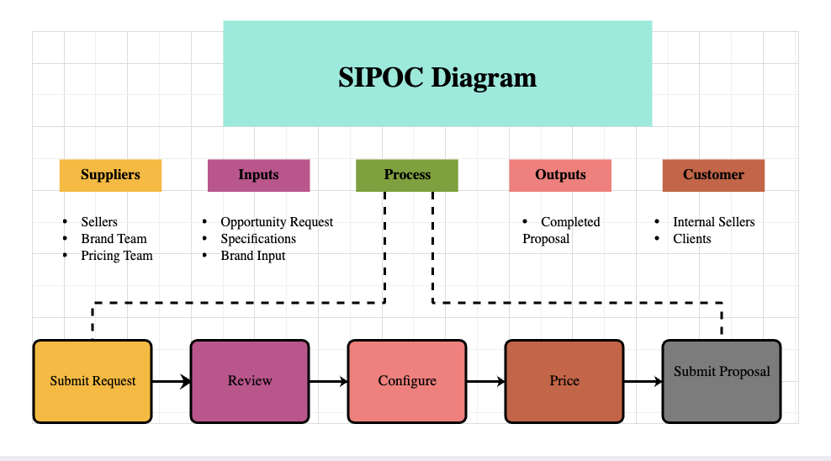
DEFINE: SIPOC Diagram

Slide 6

MEASURE: DPMO & Sigma Level
Number of Defects = 21,079 (Avg Cycle Time > 35 days)
Total Number of Opportunities = 75000
DPMO = $\frac{Number of defects}{Total number of opportunities }∗1,000,000$
DPMO = 281,053
Sigma Level = normsinv (1 - $\frac{DPMO}{ 1000000}$ ) + Process Shift (off-centering)
= normsinv(1- 0.28) + 1.5
= normsinv(0.72) + 1.5
Sigma Level = 2.08

Slide 7
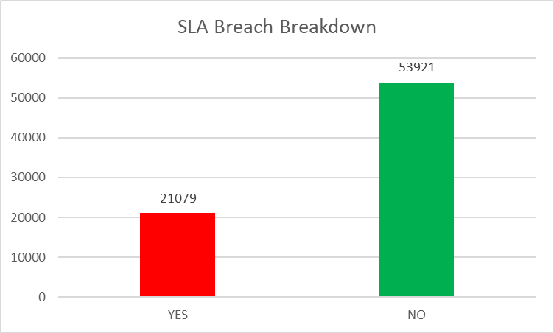
MEASURE: Key Visuals

Slide 8
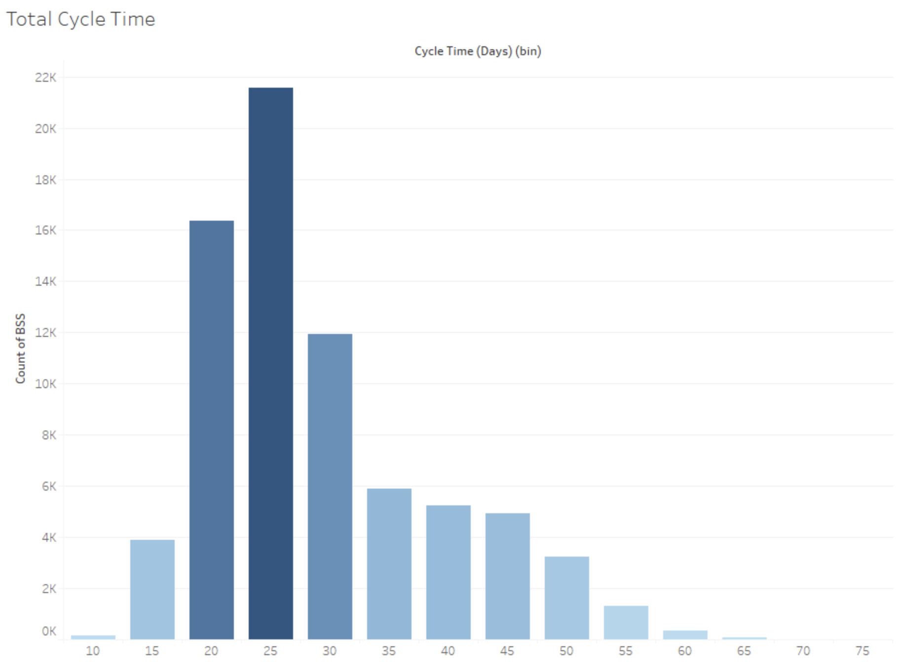
MEASURE: Key Visuals
Most proposals fall in the 20-30 days range.
Significant tail extends
Process has a high variability

Slide 9
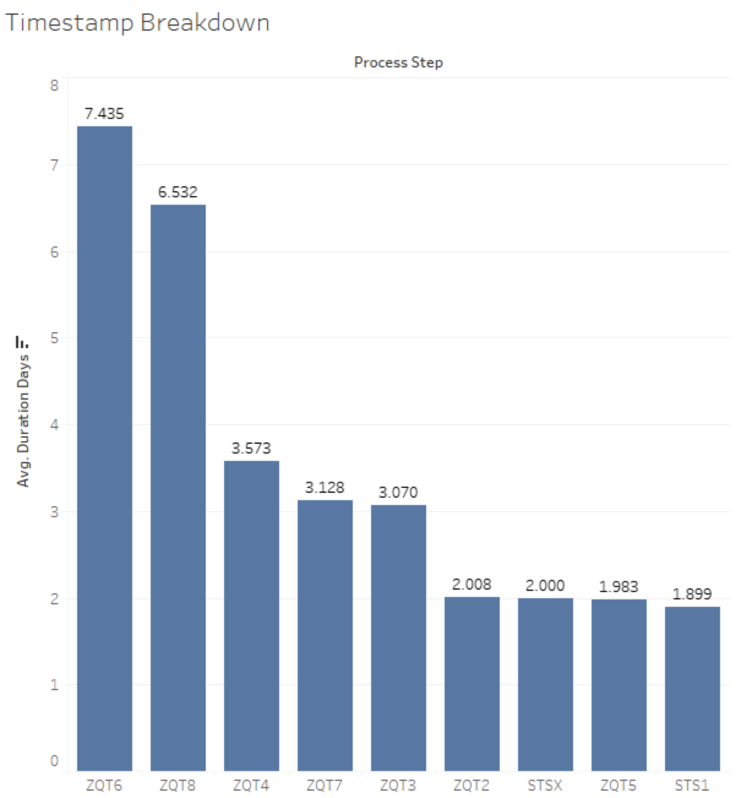
MEASURE: Key Visuals
ZQT6 takes the longest days followed by ZQT8
Biggest contributors to overall cycle time

Slide 10
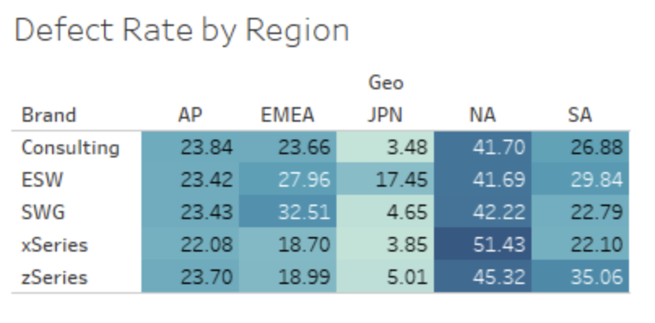
MEASURE: Key Visuals
North America (NA) and zSeries/xSeries/SWS/ESW brands have the highest defect rates, some >50% SLA violations.
Japan performs the best

Slide 11
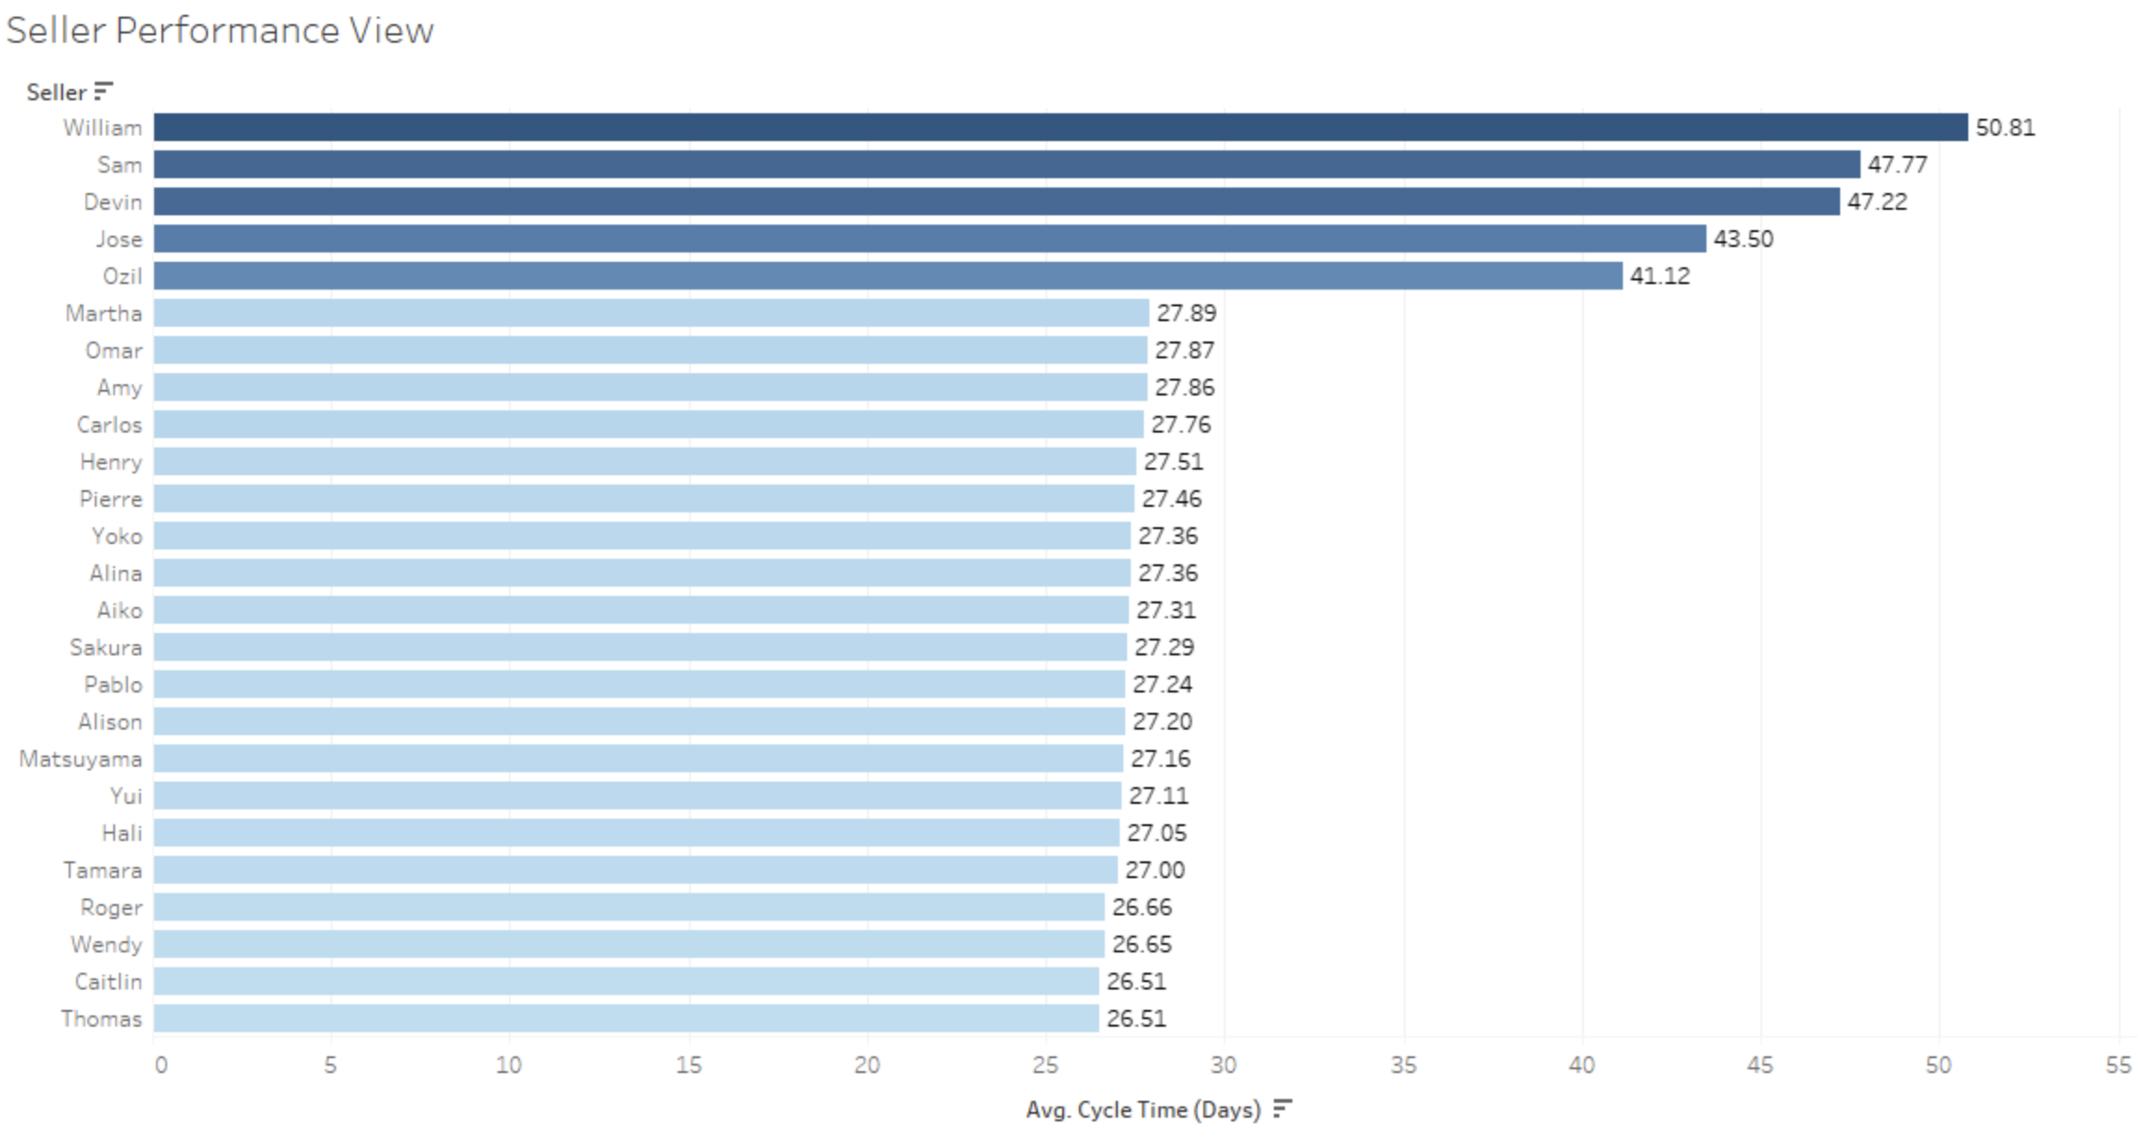
MEASURE: Key Visuals
The chart ranks the best sellers by average cycle time
Lower the better

Slide 12
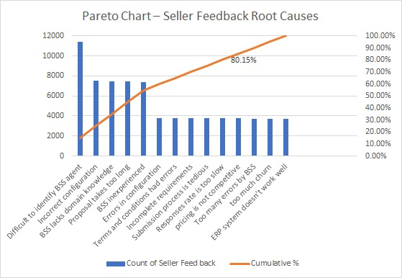
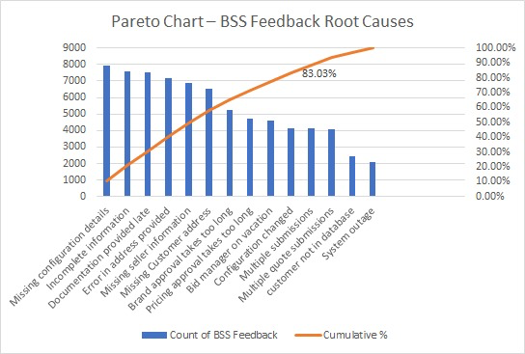
MEASURE: Key Visuals

Slide 13

ANALYZE: Value based Lean
Timestamp | Example Analysis | Value based leanType | No of Days
STS1 | Seller submits the opportunity | Value Added | 1
ZQT2 | BSS check routing — often causes delays | Non-Value Added but needed | 2
ZQT3 | Waiting for missing seller info | Non-Value Added & not needed | 3
ZQT4 | Manager review | Non-Value Added but needed | 3.5
ZQT5 | Product configuration Creation | Value Added | 2
ZQT6 | Review & Reconfig - often causes delay | Non-Value Added & not needed | 7.5
ZQT7 | Seller , Brand Manager Approval - often causes delay | Non-Value Added & but needed | 3
ZQT8 | Final doc preparation | Value Added | 6.5
STSX | Proposal submitted to customer | Value Added | 2
Value-Added = 11.5 days
Total Cycle Time = 31.6 days
PCE = $\frac{Value−Add TIme}{Process Cycle Time}$
PCE = 0.377

Slide 14
ANALYZE: 5 WHY’s
Why are proposals delayed? Because the cycle time exceeds 35 days.
Why does the cycle time exceed 35 days? Because it takes too long to get the right information and approvals.
Why is there delay in getting the right info? Sellers often submit incomplete data.
Why do sellers submit incomplete data? Because there’s no input validation or checklist.
Why is there no validation or checklist? Because the ERP doesn’t enforce required fields and business rules.

Slide 15
ANALYZE: FMEA
Failure Mode | Severity (S) | Occurrence (O) | Detection (D) | RPN
Missing seller input | 9 | 8 | 7 | 504
Reconfiguration due to spec error | 8 | 7 | 6 | 336
Approval backlog (Brand Manager) | 7 | 6 | 8 | 336
BSS mismatch to bid type | 6 | 5 | 7 | 210
Incorrect pricing entered | 6 | 5 | 6 | 180

Slide 16
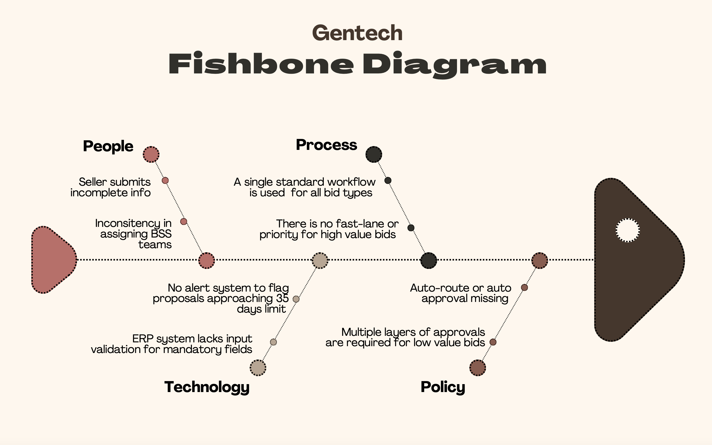
ANALYZE: Fishbone Diagram

Slide 17
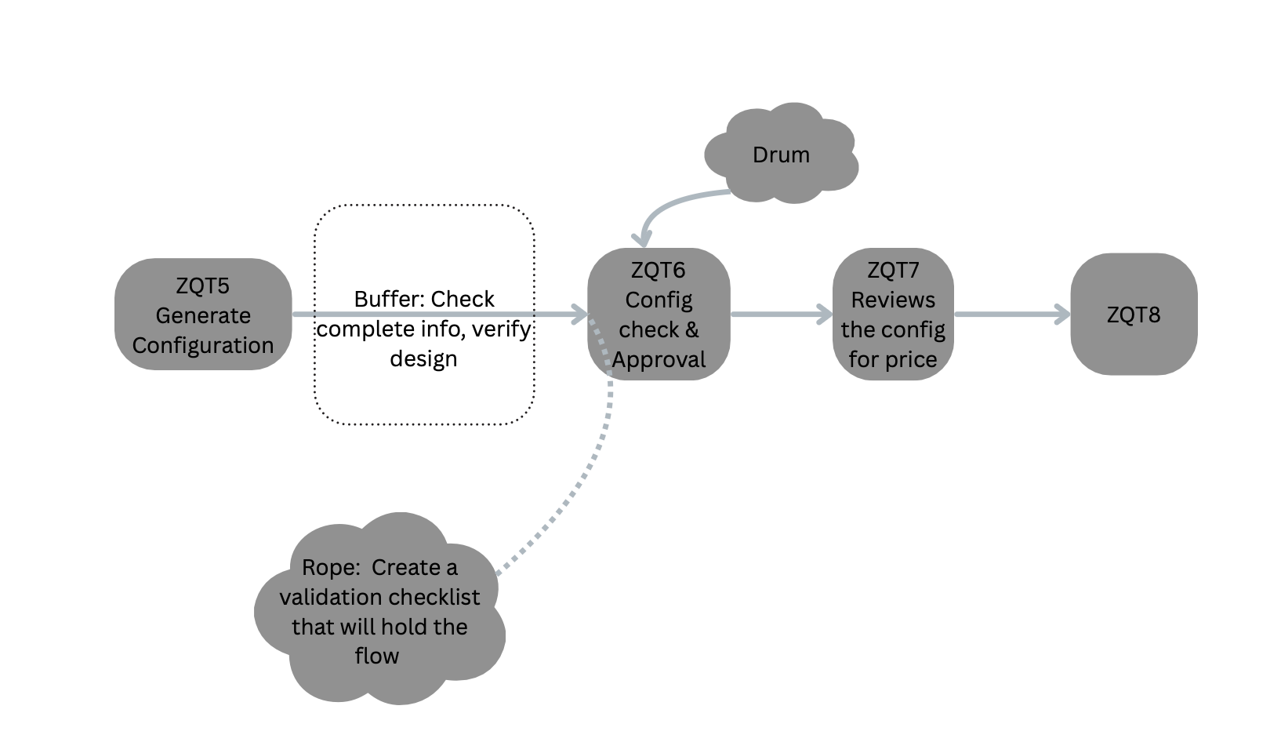
ANALYZE: DBR

Slide 18
IMPROVE: RPA
Robotic Process Automation (RPA):
Automates required field validation before submission
Intelligent auto-routing to BSS based on bid type, size, geography, and product line
Auto-reminders for seller inputs — e.g., if no response in 24 hrs. post-ZQT3 trigger
Use of standardized documentation template
Impact:
Saves 3-4 days per proposal
Reduces rework by 40%
Cuts seller-related waiting time by 20–30%

Slide 19
IMPROVE: Poka-Yoke
Dynamic forms that adapt based on bid type/brand
If brand = “xSeries” → prompt for config specs
If bid size > $100K → unlock legal/compliance fields
If customer = Gov sector → attach security terms

Slide 20
CONTROL: Control Plan
Process Step | Measure | Method | Frequency | Response if Out of Control
Seller Intake | Completion % of checklists | ERP form field validation | Every request | Reject & auto-request correction
Proposal Creation | Avg cycle time per brand | Tableau dashboard | Weekly | Escalate if avg >33 days
SLA Violation | % proposals > 35 days | Live SLA Tracker | Daily | Manager alert & root cause log
Rework Frequency | % with reconfig needed | Flag via feedback category | Weekly | Re-train seller / flag template
Approval Duration | Avg approval turnaround time | ERP time stamps | Weekly | Auto-route to alternate approver

Slide 21
PROJECT IMPACT: Post Improvement
Metric | Baseline | After Improvement | % Change
Avg Cycle Time | 31.63 days | ~26.9 days | ↓ ~15%
SLA Breach Rate | 28% | <10% | ↓ ~64%
DPMO | 281,053 | ~66,800 | ↓ ~76%
Sigma Level | 2.08 | ~4.0 | ↑ Improved
Rework Frequency | Medium–High | Low | ↓

Slide 22
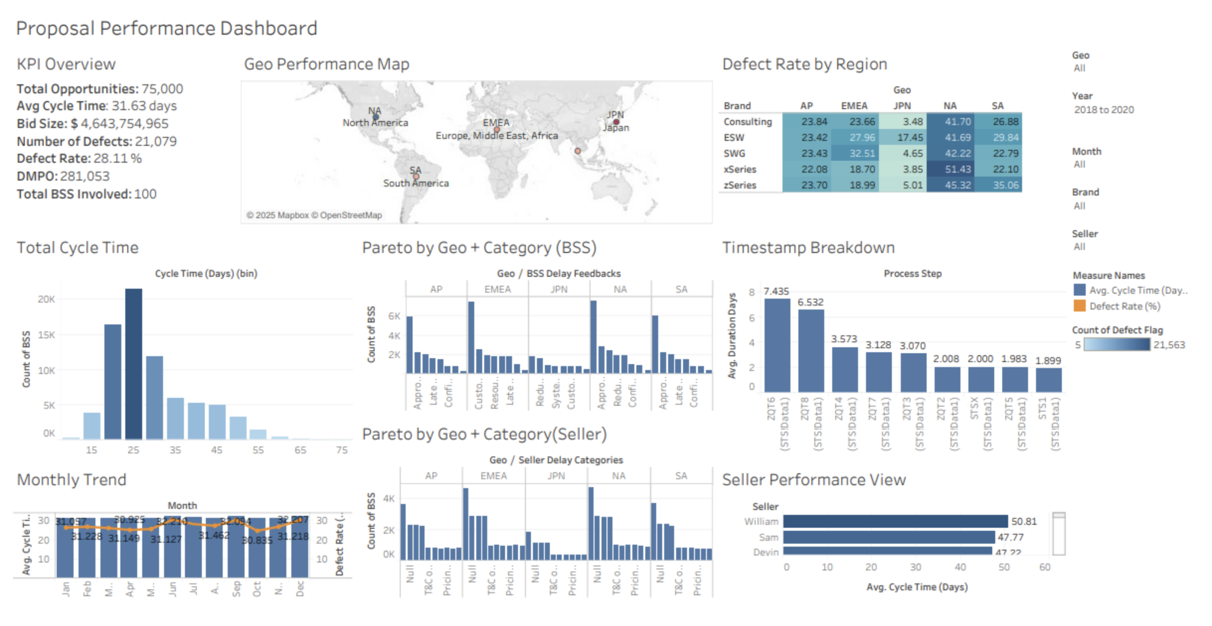
TABLEAU

Slide 23

Thank You

